Slide 1
TODAY’S EVENT
Wi-Fi:
HCL_Public
Password:
n/a
#mimatweet
blog.mima.org
Tactics in Twenty: Data + Tech
NINA HALE | Founder | Nina Hale Inc. | @ninahale
JOSH BECERRA | Co-Founder | Monkey Island Inc. | @joshbecerra
CHRISTINA LEFEBVRE | Marketing Automation Consultant | Antenna
Photo courtesy of creative commons license: https://www.flickr.com/photos/piet_musterd/9325260197/

Slide 2
Nina Hale: Overview & attracting qualified visitors @ninahale
Josh Becerra: Conversion optimization @joshbecerra
Christina Lefebvre: Marketing automation

Slide 3
Attracting the right audience
@ninahale
#mimatweet

Slide 4
There is no “digital” consumer

Slide 5
The Consumer Journey
THEN: The Purchase Funnel
NOW: The Consumer Journey
Awareness
Familiarity
Consideration
Purchase
Loyalty
Evaluate
Decision trigger
Consider
Commit
Buy
Advocate
Interest trigger
Experience
@ninahale
#mimatweet

Slide 6
But in Reality…
Paid
Media
Follow on LinkedIn
Follow
on Twitter
Compare Online
Connect on Facebook
Read Blog
Lead
Read
Reviews
Research on Website
Watch YouTube Video
Social Media Referral
@ninahale
#mimatweet

Slide 7
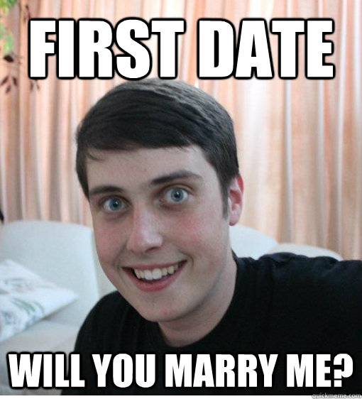
Notes:
So how do we find them at the right time?

Slide 8
@ninahale
#mimatweet

Slide 9
Research website and keyword searches to learn what they care about
Create content to meet that need
Use paid to get the content in front of them
Sponsor posts to targeted audiences (their engagement also helps your SEO)
Programmatic display
Paid Search
Remarket to drop-offs
Find look-alike audiences that match your best customers
@ninahale
#mimatweet

Slide 10
Target the right people, in the right place, at the right time in their journey
Provide them with a clear compelling reason to believe
Develop a dialog that shows they are important to you and helps them navigate the next step
@ninahale
#mimatweet

Slide 11
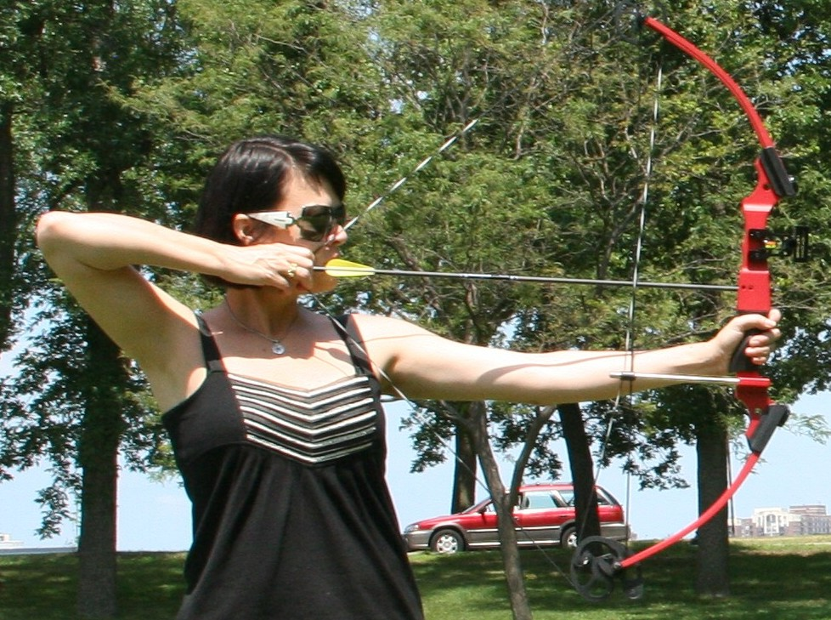
Targeting
Search engines
Programmatic display – (50% of all display)
Promoted social
Email lists and segments
Retargeting and look-a-likes
@ninahale
#mimatweet
Notes:
More searches on mobile phones than on desktops now!
Facebook “call now” CTA

Slide 12
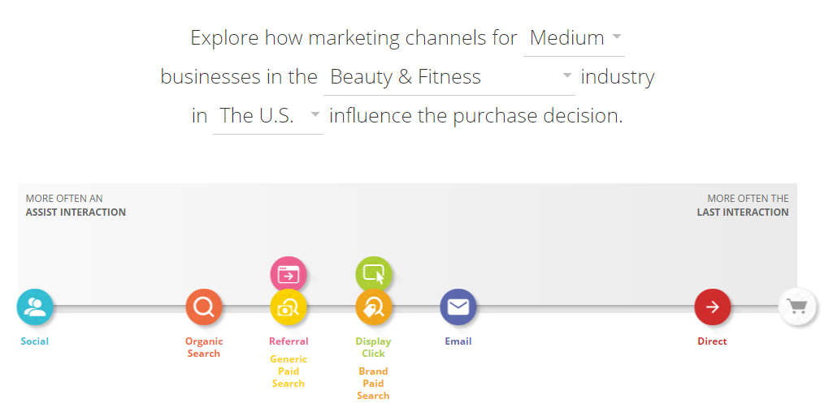
Industry Benchmarking
@ninahale
#mimatweet
https://www.thinkwithgoogle.com/tools/customer-journey-to-online-purchase.html
Notes:
How do you start u=to understand what all those steps are in the process? And which ones made a difference in the sales process? Google has this tool which shows you a benchmark for your industry. EXPLAIN THIS SLIDE IN DETAIL

Slide 13
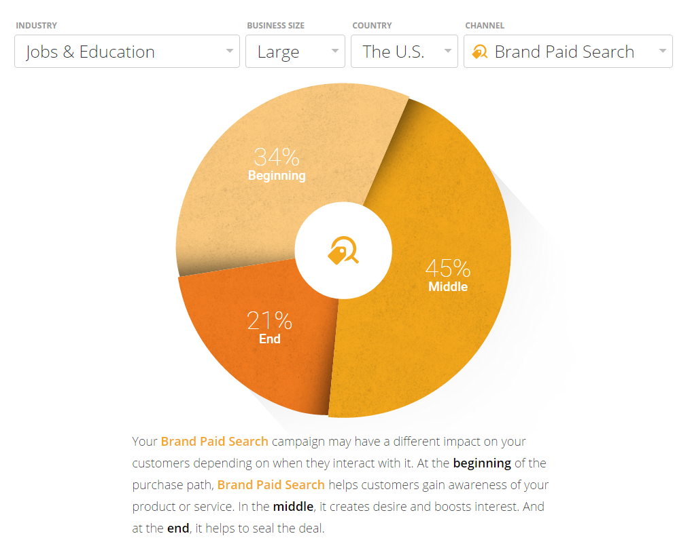
Examine By Channel
@ninahale
#mimatweet
https://www.thinkwithgoogle.com/tools/customer-journey-to-online-purchase.html
Notes:
You can even drill in deeper to understand on average which point in the journey each channel may impact the process

Slide 14
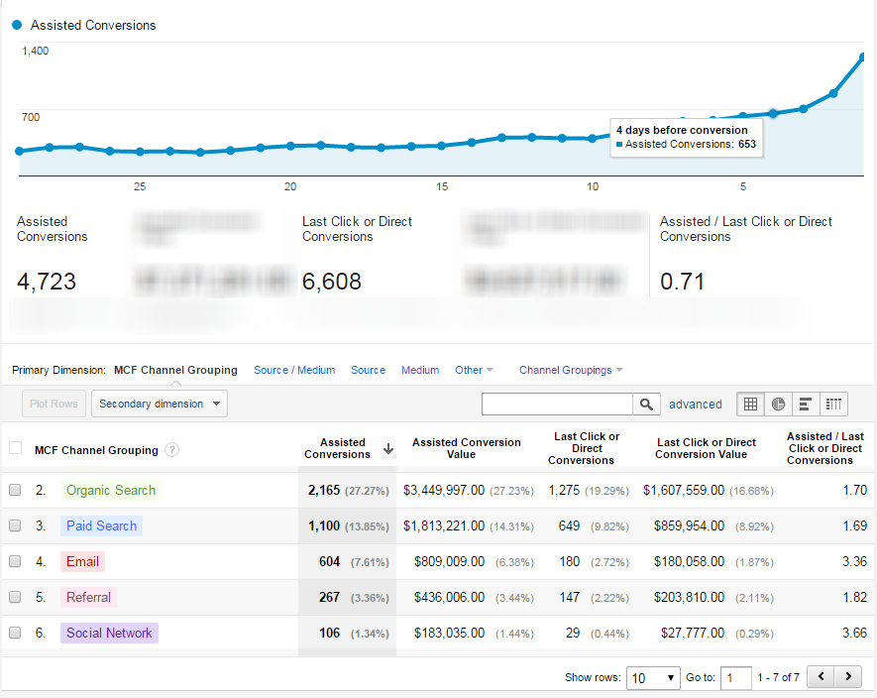
Test How Yours Interacts
@ninahale
#mimatweet
Notes:
It shows the impact of different channels on the end sale. So you should be looking at those to determine which ones should be higher up in the funnel for your marketing plan – and modify the message and call to action accordingly. EXPLAIN THIS SLIDE AND CHARTS

Slide 15
Align Your Message
Targeted Audience
Acknowledge need
Free guide
Search Term
We have that!
Why we’re best
Retarget
You left!
Act now!
@ninahale
#mimatweet

Slide 16
Tactical Takeaways
Explore your web stats to determine how each marketing activity impacts each other
Install Quantcast and Google demographics to gain insights on your audience
Acknowledge the costs of brand activities when measuring brand searches
Explore targeting opportunities across display, search and social
Qualified traffic is only the beginning! It’s the attraction, not the courtship, or the wedding.
@ninahale
#mimatweet

Slide 17
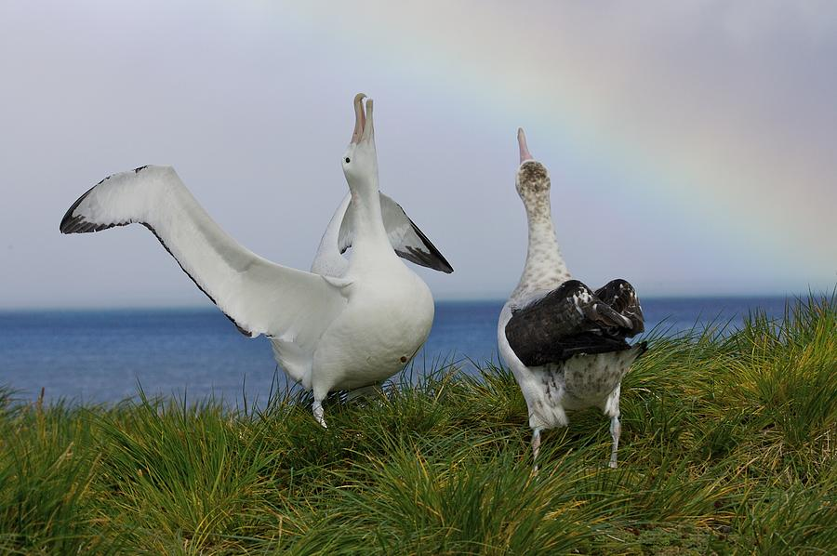
Notes:
Now let the courtship begin!

Slide 18
Conversion Optimization (CRO)

Slide 19
Conversion Optimization
Align Goals
Track Everything
Run Experiments
Iterate
@joshbecerra
#mimatweet

Slide 20
1) Align Goals
@joshbecerra
#mimatweet

Slide 21
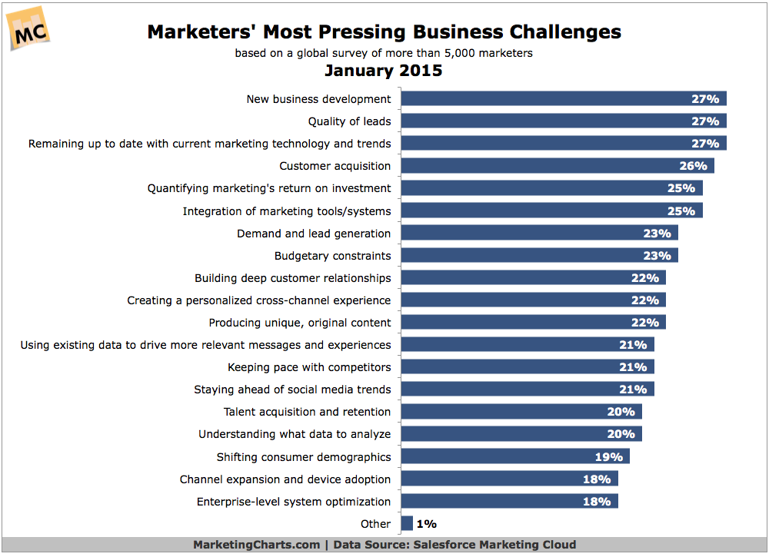
@joshbecerra
#mimatweet

Slide 22
Email
Marketing
SEO + SEM
Social Media
Marketing
Website
Landing
Pages
Leads
$ $
$
@joshbecerra
#mimatweet

Slide 23
Call You
Fill Out a Form
Download a Whitepaper
or a Product Spec Sheet
Put Something in a Shopping Cart and Buy it
Watch a Video
Start a Free Trial
@joshbecerra
#mimatweet

Slide 24
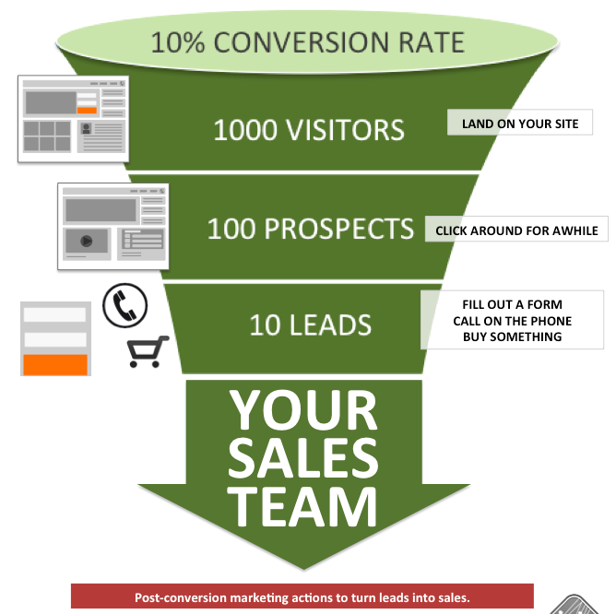

Slide 25
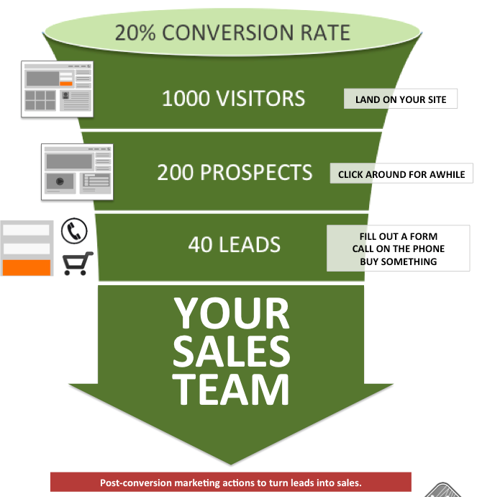

Slide 26
2) Track Everything
@joshbecerra
#mimatweet

Slide 27
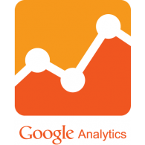
@joshbecerra
#mimatweet

Slide 28
@joshbecerra
#mimatweet

Slide 29
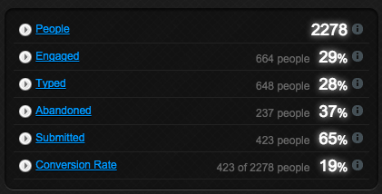
@joshbecerra
#mimatweet

Slide 30
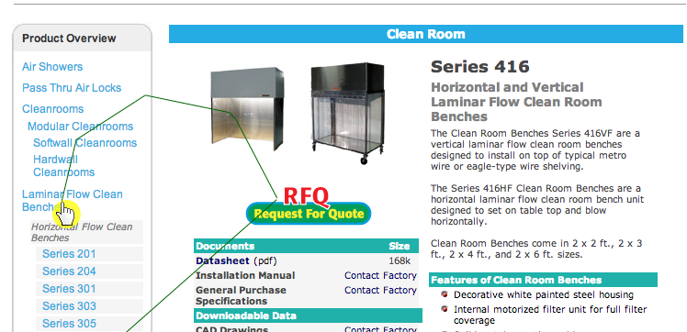
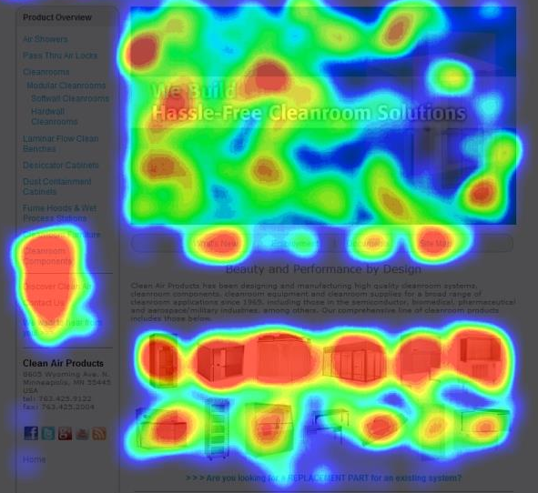
@joshbecerra
#mimatweet

Slide 31
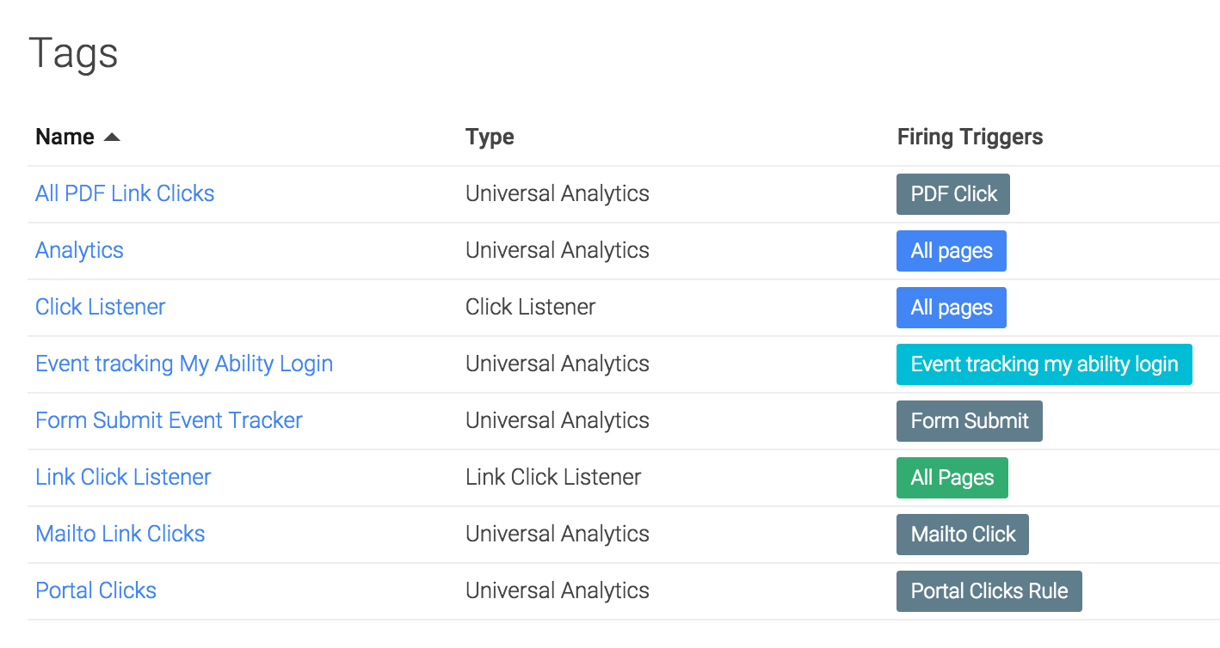
@joshbecerra
#mimatweet

Slide 32
3) Run Experiments
@joshbecerra
#mimatweet

Slide 33
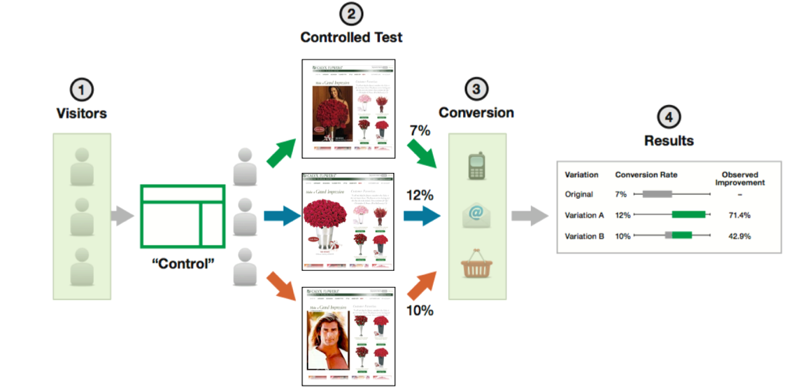
@joshbecerra
#mimatweet

Slide 34
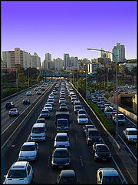
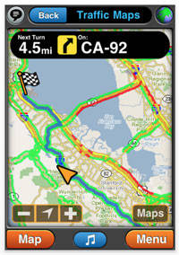
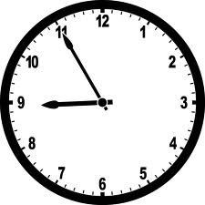
VALUE PROPOSITION – Driving to an Important Appointment @ 9AM
URGENCY
ANXIETY
DISTRACTION
RELEVANCE
CLARITY
@joshbecerra
#mimatweet

Slide 35
4) Iterate
@joshbecerra
#mimatweet

Slide 36
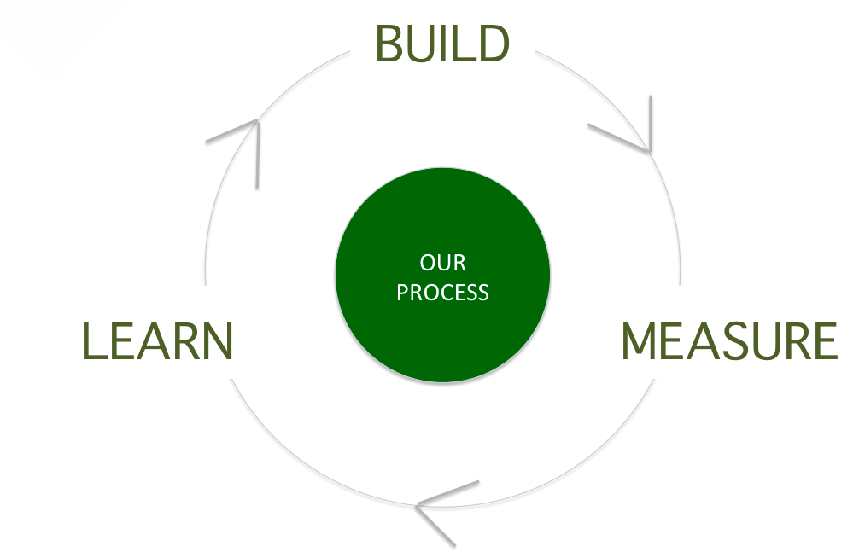
A website
is always in
BETA!
@joshbecerra
#mimatweet

Slide 37
Tactical Takeaways
Align Goals – Work with clients on what each conversion action is worth based on their close rate and lifetime value of a customer. Then go get them more conversions!
Track Everything – Measure and monitor which channels are delivering results, use multi-channel funnels and attribution modeling to decipher how channels are work together.
Run Experiments – Leverage qualitative and quantitative data to develop hypotheses to test using A/B and multi-variant testing.
Iterate – Change your mindset, a website should always be in beta. Never stop testing ways to improve performance and increase ROI.

Slide 38
Rewards + Realities of Marketing Automation
Christina Lefebvre
Marketing Automation Consultant, Antenna

Slide 39
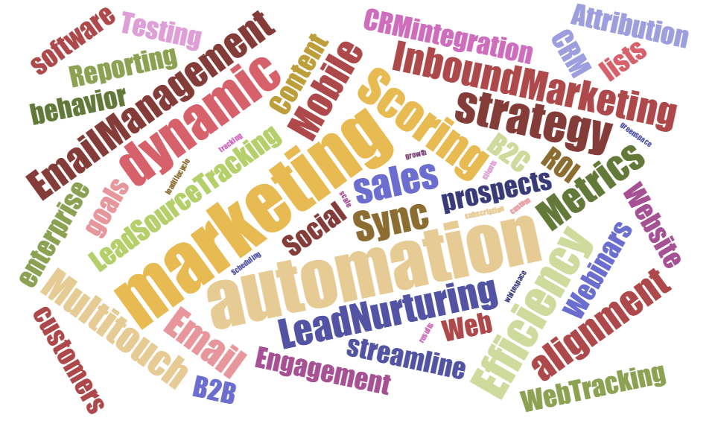

Slide 40
Marketing automation helps you say yes to all those questions… but faster, more efficiently and with better results.

Slide 41
Our goals as marketers
More conversions & qualified leads
Better marketing metrics
Be more efficient
Notes:
Whether you’re utilizing MA or not, these are still universal marketing goals

Slide 42
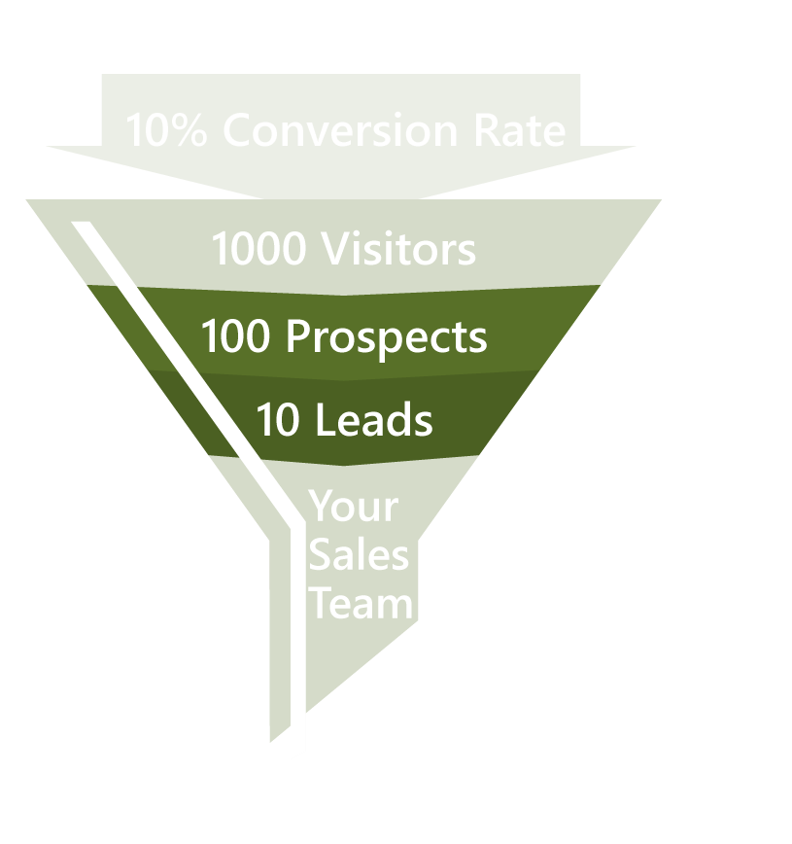
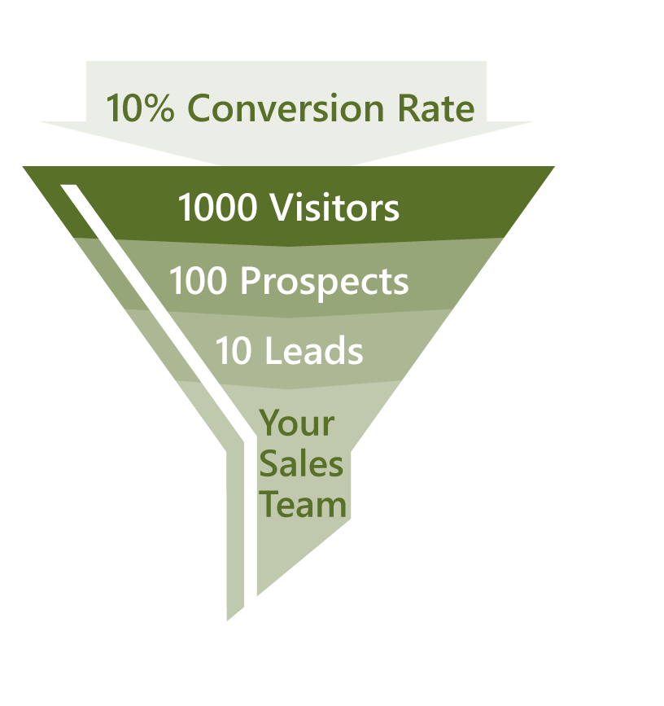
Where marketing automation amps up your funnel
Streamline and automate
Manage, measure, optimize
Increase efficiency
Modernize your marketing processes!
Notes:
Remember the funnel Josh talked about? This is where MA is focused. It helps us streamline our activities, helps us measure and increases efficiencies. We bringing in modern into our marketing…

Slide 43
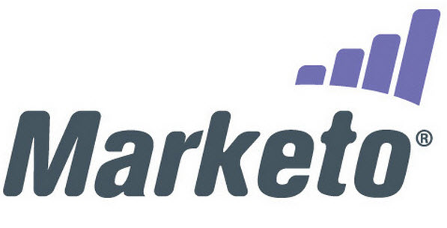

Slide 44
Rewards of marketing automation
More leads & higher quality leads
Higher conversion rates
Increased productivity
Seamless campaign execution and tracking
Measureable results
Marketing and sales alignment
Accelerates sales cycle
Enhanced targeting and personalization
Improved customer experience
Notes:
Again, cover quickly since this isn’t your main message – the tactics are!

Slide 45
What gets in the way of us achieving our marketing goals?
More conversions & qualified leads
Better marketing metrics
Be more efficient

Slide 46
Not having a process to segment our data efficiently

Slide 47
Relevant & personalized emails drive 18x more revenue than broadcast emails
(Source: Jupiter Research)
Notes:
if we’re not segmenting our data, we’re not being personal. here’s why it matters. MA not only helps you be more personal, it helps you do it much more efficiently.

Slide 48
Utilize a lead lifecycle to personalize and nurture
TACTIC

Slide 49
Assign a “stage” to everyone so you can personalize their experience
TACTIC
Marketing Qualified Lead
Sales Accepted Lead
Anonymous
Known
Engaged
Opportunity
Won
Lost
Recycling
Disqualified

Slide 50
Companies that excel at lead nurturing generate 50% more sales ready leads at 33% lower cost.
(Source: Forrester Research)

Slide 51
How do I measure the success of my marketing strategy?

Slide 52
Can you easily answer:
Which campaigns are leading to more pipeline created?
How long does it take for leads to enter a sales cycle?
How many touch points does it take?

Slide 53
Use metrics to set goals and/or use benchmarks
TACTIC

Slide 54
Utilize marketing automation reports
TACTIC
Known
First thing someone did to interact with you (how got their name)
Engaged
All interactions that happened before they became marketing qualified/sales-ready. How many days did this take?
The thing that pushed them to be QUALIFIED
Qualified
How long does it take to become an opportunity?
Sales Accepted
Point that an opportunity opened/pipeline created/sales cycle started
Opportunity
Marketing activity/interactions while they were in a sales cycle
How long is the average sales cycle?
Closed Won

Slide 55
Marketing automation will not be all rainbows and butterflies
Reality:

Slide 56
Critical elements for utilizing marketing automation
Database integrity
Resources
*Human capital
Proper planning

Slide 57
Over 75% of marketers responded that they are not using their marketing automation platform to its fullest potential yet.
(Source: Focus Research, 2014)
Notes:
“Over 75% of marketers responded that they are not using their marketing automation platform to its fullest potential yet”

Slide 58
Tactical Takeaways
Utilize a lead lifecycle to accomplish personalization & nurturing
*Qualify leads before sending to sales
Use lead lifecycle reports/metrics to help determine marketing strategy

Slide 59
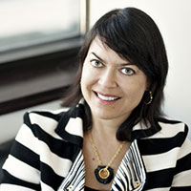
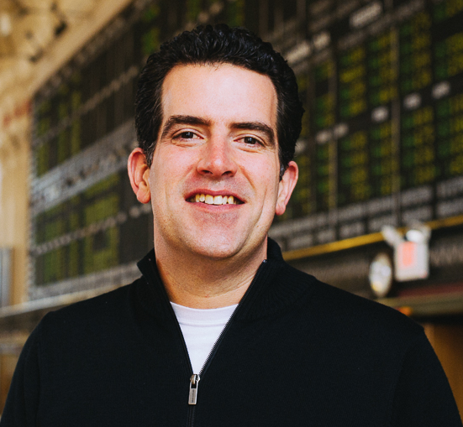
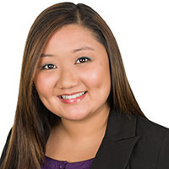
Thank you!
Tactics in Twenty:
Data + Tech
NINA HALE - @ninahale
Founder | Nina Hale Inc.
JOSH BECERRA - @joshbecerra
Co-Founder | Monkey Island Inc.
CHRISTINA LEFEBVRE
Marketing Automation Consultant | Antenna
Photo courtesy of creative commons license: https://www.flickr.com/photos/piet_musterd/9325260197/
Notes:
Speaking notes:
One important call out: Due to time constraints, we will not have Q&A at today’s event but I encourage you to reach out to the speakers following today’s presentation.
[Below is the description from the website, feel free to paraphrase]
Introducing: Tactics in Twenty. The first of two events we'll host this year where three speakers will each give you twenty minute knowledge bombs, rooted in strategy, but with the goal of arming you with nine total tangible takeaways to take back to the office.
This month, we're focused on data-based and technical practices—and we can't imagine three more qualified experts to leave you feeling educated and armed to tackle some of the most powerful tactics in digital marketing today.
(Nina is presenting first)
NINA HALE | Founder | Nina Hale Inc.
JOSH BECERRA | Co-Founder | Monkey Island Inc.
CHRISTINA LEFEBVRE | Marketing Automation Consultant | Antenna

